Slide 1
Lytle Animal Allies Website
ARL Technology

Slide 2
Needs Statement
Purpose
The following documentation describes the usages and purpose of the project, of which consists of a website for the Animal Rescue organization. The website is designed to advertise the non-profit organization, including gaining awareness, asking for donations to the above described organization, and offering the adoption of animals. The project will be responsively designed to be compatible with desktop and mobile phones.
The Website Needs Statement
This website will be designed to assist families in looking for a pet and make donations. In addition, it will also be a community to blog about events and updates and for anyone who wants to help volunteer.
1. Various Pages of the Website
1.1. Homepage with news, website/organization advertising, and alternative links to other pages
1.2 Donations page to donate or purchase animals
1.3 Various pages powered by the PetFinder API to view available animals
1.4 Blog for asking questions and getting pet help
1.5 Responsive web design for mobile use
2. Home Page
2.1 Overview of Announcements/Events being held
2.2 Advertising/ Links to other pages
2.3 Overview of what animals are available

Slide 3
Needs Statement (cont)
3. Donations Page
3.1 How to donate
3.2 Forms of payment accepted
3.3 Adoption requirements
4. Adoption Page
4.1 Option to either search for cats or dogs OR two separate pages
4.2 Login page
4.3 Search option for lost or stolen pets
5. Blog Page
5.1 Community to help new pet owners
5.2 Ask questions regarding pet health
5.3 Ability to leave comments on a post
6. Events Page
6.1 Calendar depicting events
7. RBAC capabilities
7.1 Login and Logout pages
7.2 Register page
7.3 Admin page to change levels of access
7.4 Add blog page
7.5 Add event page

Slide 4

Use Case Diagram
View Registration Page
Color | Desc
Orange | Unassigned User
Blue | Signed-In User
Green | Signed-In Admin
User
View Home Page
Create New Account
View Website
Login Using Account
View Events Page
View Blog Page
View Donation Page
View Adoptions Page
Flag, Relocate, or Delete Posts
Search PetFinders for Pets
Admin
Add or Remove Events
Adopt an Animal
View Donation Amounts
Sign Up for Events
Donate $Money$
View Blog Posts and Help
Alter Donation Costs
Interact with Calendar to See Events
Interact with Posts (comment, like, save, post)

Slide 5
Use Case: Website
This represents permanent elements that are visible anywhere on the website
Use Case: Register Page
Allows user to create account and login
Use Case: Home Page
This is the first page to appear when website opens
Actions | Response
1. User clicks “New Account” button 3. User clicks “Sign Up” | 2. New page opens requesting information such as name, username, email, and password 4. If fields are empty, the user is told to fill them 5. If a user already exists with the user’s new username and email, a warning pops up so the user can change it 6. If no problems exist, the new user’s data is added into the db
1. User clicks “Login” 3. User inputs username or email, and password | 2. Login page opens 4. If incorrect, the user is told “Username or email and password are incorrect”. If they fail 3 times, a warning is sent to the email 5. If the username/email and password are correct, the last page open opens
Actions | Response
1. User clicks “Register” on the screen | 2. System follows “Register” User case
1. User clicks on an image in the carousel | 2. Depending on the picture clicked, a new page opens in “Events” showing the details of the event whether it has passed or not
1. User clicks on an advertisement for a donation deal | 2. System follows “Donate” page
1. User clicks on an advertisement for a pet | 2. System follows “Adopt” page
1. User clicks on a pinned post | 2.
Actions | Response
1. User clicks “Homepage” in Nav bar | 2. “Home” page opens
1. User clicks “Blog” in Nav bar | 2. “Blog” page opens
1. User clicks “Adoptions” in Nav bar | 2. “Adoptions” page opens
1. User clicks “Donate” in Nav bar | 2. “Donate” page opens
1. User clicks “Events” in Nav bar | 2. Website reloads
1. User clicks “Register” in top right of screen | 2. System follows “Register” Use case

Slide 6
Use Case: Events Page
Contains a calendar, and a separate list, of upcoming events
Use Case: Blog Page
Contains a calendar, and a separate list, of upcoming events
Use Case: Adopt Page
Uses the PetFinders API to aid in pet adoption
Actions | Response
1. User clicks on day in calendar 3. User clicks on a link in the view 5. User clicks “Attend” on the detail page to sign up for the event | 2. A small view appears displaying info of the event 4. A new tab opens to show detailed view of event 6. System follows “Register” Use case. If login is successful, the account is added to list of attendees
1. User scrolls through list of events 3. User clicks on link in the list | 2. The list scrolls down (from top) in order of most recent to next 4. A new tab opens to show detailed view of event
Actions | Response
1. User scrolls through posts | 2. Each post is visible (from top) in order of newest to oldest
1. User smacks the “like” button (looks like a paw) | 2. If user is not logged in, system follows “Register” Use case. If login is successful, the “like” is permitted and added to the user’s “liked” posts in db
1. User makes a comment on a post | 2. If user is not logged in, system follows “Register” Use case. If login is successful, the comment is saved in db and visible for everyone
1. User makes a post | 2. If user is not logged in, system follows “Register” Use case. If login is successful, the post is saved in db and is visible to everyone
Actions | Response

Slide 7
Use Case: Donate Page
Contains ads and instructions for donating money to the organization
Actions | Response
1. User clicks on the “Volunteer” button 3. User fills in info about name, volunteer position to fill, phone number, and if required time they will help (“from xx:xx to xx:xx”) | 2. If user is not logged in, system follows “Register” Use case. If login is successful, the user is shown a list of events where volunteering is available 4. User is added to volunteer list and will get an email and/or text as a reminder; additionally, it can add a Google Calendar event (?)
1. User can select one of the available donation options ($1-5, $6-10, $11-20, custom amount) | 2. If user is not logged in, system follows “Register” Use case. If login is successful, a new page will open with the donation amount and card inputs 3. If user selects custom option, they are given a wider range with exact amount (including cents)
Actions Cont. | Response Cont.
4. User inputs credit/debit card information 5. User clicks “Submit Donation” 8. The user clicks cancel in the confirmation 10. The user clicks confirm in the confirmation | 6. If the info is not in the right format or there is an empty input, a warning will appear and stop the transaction 7. If the information is properly complete, a new page will appear for the user to confirm donation 9. No money is donated, and the page returns to “Donate” Page 11. The transaction is completed and the page returns to “Donate” Page 12. An email is sent to the user thanking them. In addition, if the donation is attached to an offer the email will contain info on how to collect offer

Slide 8
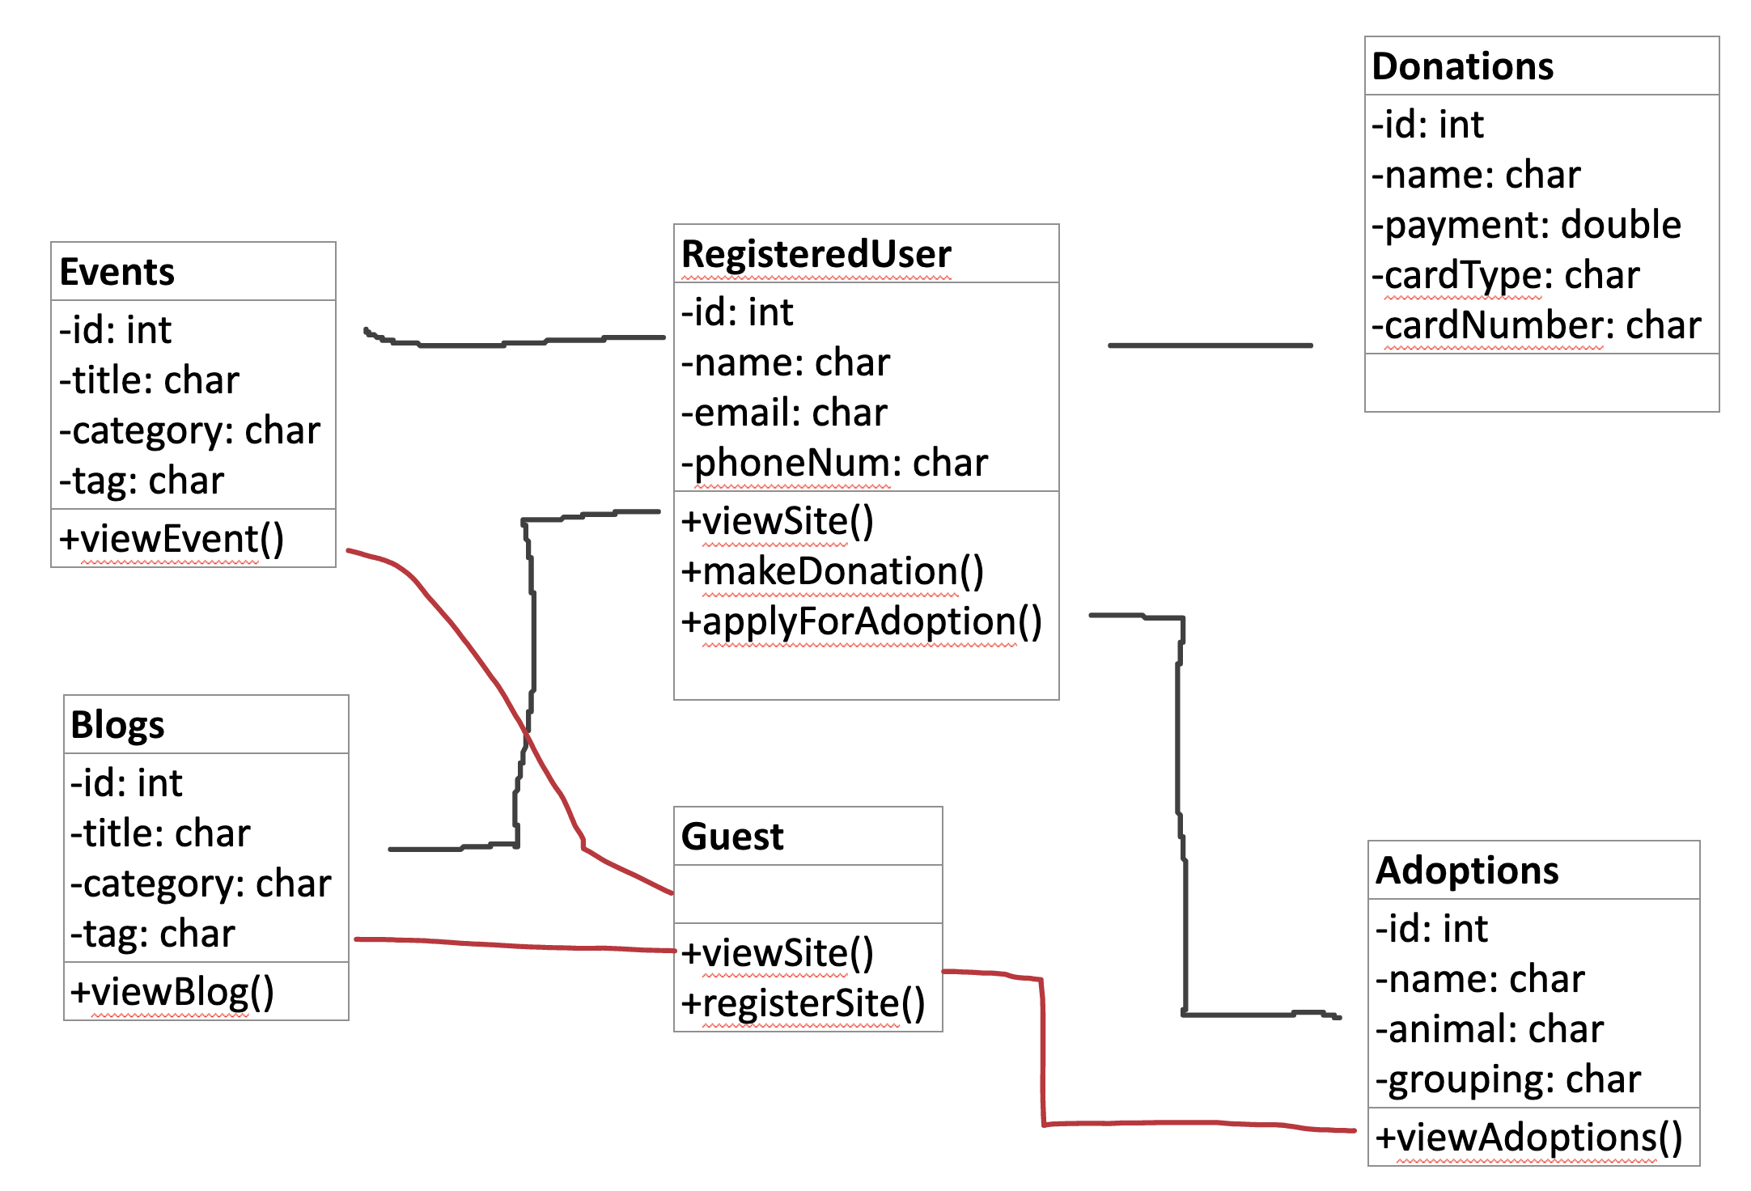
Class Diagram

Slide 9
User
Attribute
Function
User
Attribute
Function
User
Attribute
Function
User
Attribute
Function

Slide 10
Class Diagram (cont)
ARL Technologies – Animal Rescue Non-Profit Website
Needs Statement
Purpose
The following documentation describes the usages and purpose of the project, of which consists of a website for the Animal Rescue organization. The website is designed to advertise the non-profit organization, including gaining awareness, asking for donations to the above described organization, and offering the adoption of animals. The project will be responsively designed to be compatible with desktop and mobile phones.
The Website Needs Statement
This website will be designed to assist families in looking for a pet and make donations. In addition, it will also be a community to blog about events and updates and for anyone who wants to help volunteer.
1. Various Pages of the Website
1.1. Homepage with news, website/organization advertising, and alternative links to other pages
1.2 Donations page to donate or purchase animals
1.3 Various pages powered by the PetFinder API to view available animals
1.4 Blog for asking questions and getting pet help
1.5 Responsive web design for mobile use
2. Home Page
2.1 Overview of Announcements/Events being held
2.2 Advertising/ Links to other pages
2.3 Overview of what animals are available
3. Donations Page
3.1 How to donate
3.2 Forms of payment accepted
3.3 Adoption requirements
4. Pet Search Pages
4.1 Option to either search for cats or dogs OR two separate pages
4.2 Login page
4.3 Search option for lost or stolen pets
5. Blog Page
5.1 Community to help new pet owners
5.2 Ask questions regarding pet health
5.3 Ability to leave comments on a post
6. Events Page
6.1 Calendar depicting events
7. RBAC capabilities
7.1 Login and Logout pages
7.2 Register page
7.3 Admin page to change levels of access
7.4 Add blog page
7.5 Add event page

Slide 11
:Blog Page
:Events Page
:Database
Post:Table
:Register Page
server
registrationLink
blogPosted
registrationRequest
:BlogAdd Page
User:Table
validateRegistration
registeredUser
addRegistration
Event:Table
eventPosted
:EventsAdd Page
registrationConflict
registeredUser

Slide 12
Risk Analysis Table
Risk Title | Likelihood | Impact | Retirement Cost | Priority | Retirement/mitigation plan | Responsible member | Target Completion Date
Deficient Node.jsskills | 6 | 6 | 5 | 125 | https://www.youtube.com/watch?v=fBNz5xF-Kx4 | Rey Crittenden | Sept 7, 2020
Deficient MongoDBskills | 7 | 7 | 2 | 32 | https://www.youtube.com/watch?v=pWbMrx5rVBE | Rey Crittenden | Sept 3, 2020
OAuth 2.0 API integration | 9 | 9 | 8 | 32 | https://gomakethings.com/using-oauth-with-fetch-in-vanilla-js/ | Rey Crittenden | Sept 1, 2020
Deficient HTML/CSS skills | 3 | 6 | 3 | 120 | freecodecamp.com | Rey Crittenden | Sept 9, 2020
Deficient vanilla JSskills | 6 | 8 | 4 | 60 | https://www.youtube.com/watch?v=hdI2bqOjy3c&list=PLFrkAJE7izdrkyh34mtwViEn67_12mm74&index=12&t=14s | Rey Crittenden | Sept 5, 2020

Slide 13
Prototype can be found at:
https://github.com/SWE-1-Project/laa-web

